Slide 1

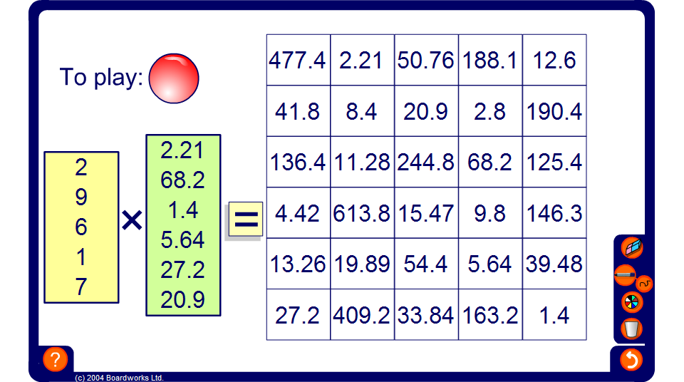


Estimation four-in-a-line
Notes:
Start by dividing the class into two teams, red and blue. Each team must select a spokesperson whose role it is to select a target square each time.
The object of the game is to get four squares in a line either horizontally, vertically or diagonally.
Decide which team will start.
The spokesperson must call out a target number from the grid, for example 69.72. Members of the team must then use approximation to estimate which two numbers from the boxes on the left would multiply together to make the target number. Using approximation, pupils must choose a number from the yellow box and a number from the green box to make the required target number. If pupils estimate that 7 × 9.96 would give the required answer, select 7 from the yellow box and 9.96 from the green box. Press the equals button and the corresponding square will be coloured in the team colour.
If the team choose the wrong numbers to multiply together to get their target square then another square will be coloured in the team colour (corresponding to the answer to their chosen calculation). If this square is already taken then a message stating that the square is unavailable will appear.
Play then passes to the opposing team.
The game continues until one team gets four in a line or every square in the grid is coloured.

